Slide 1
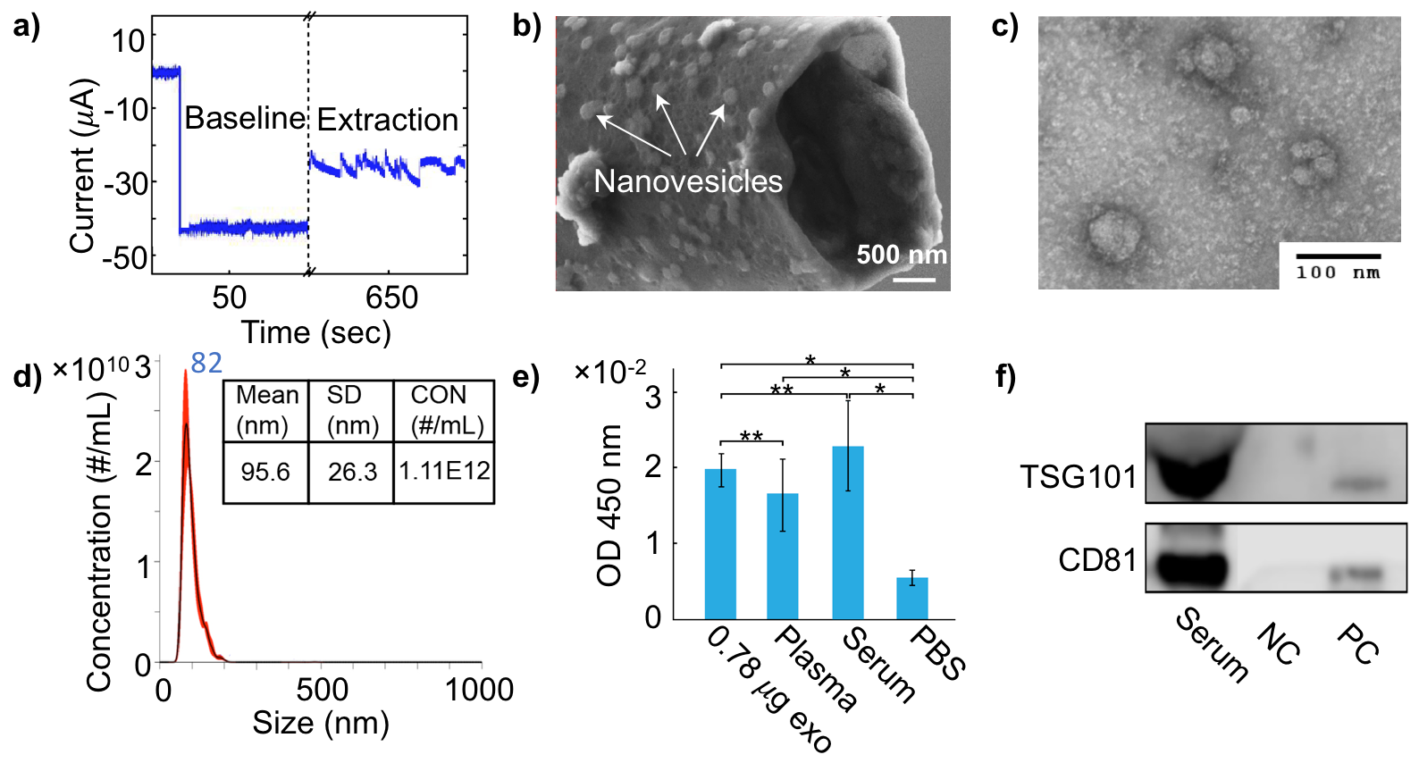
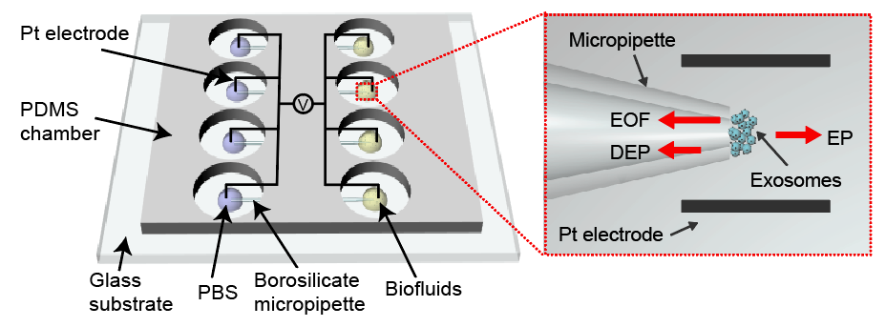
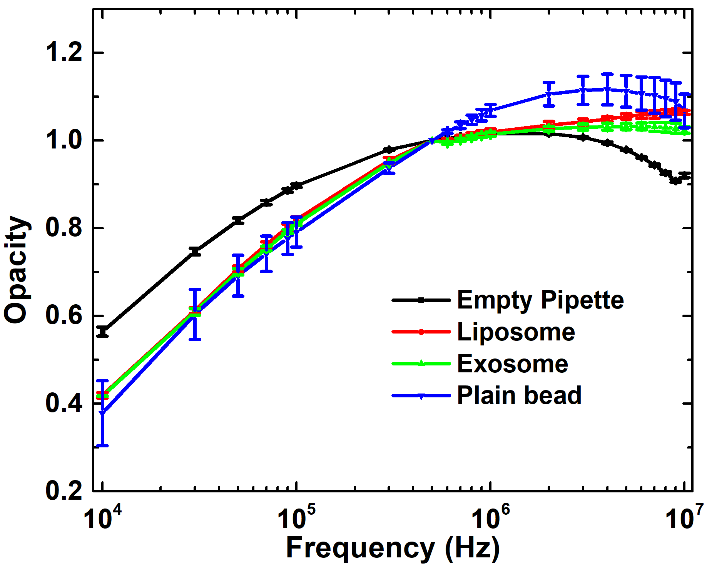
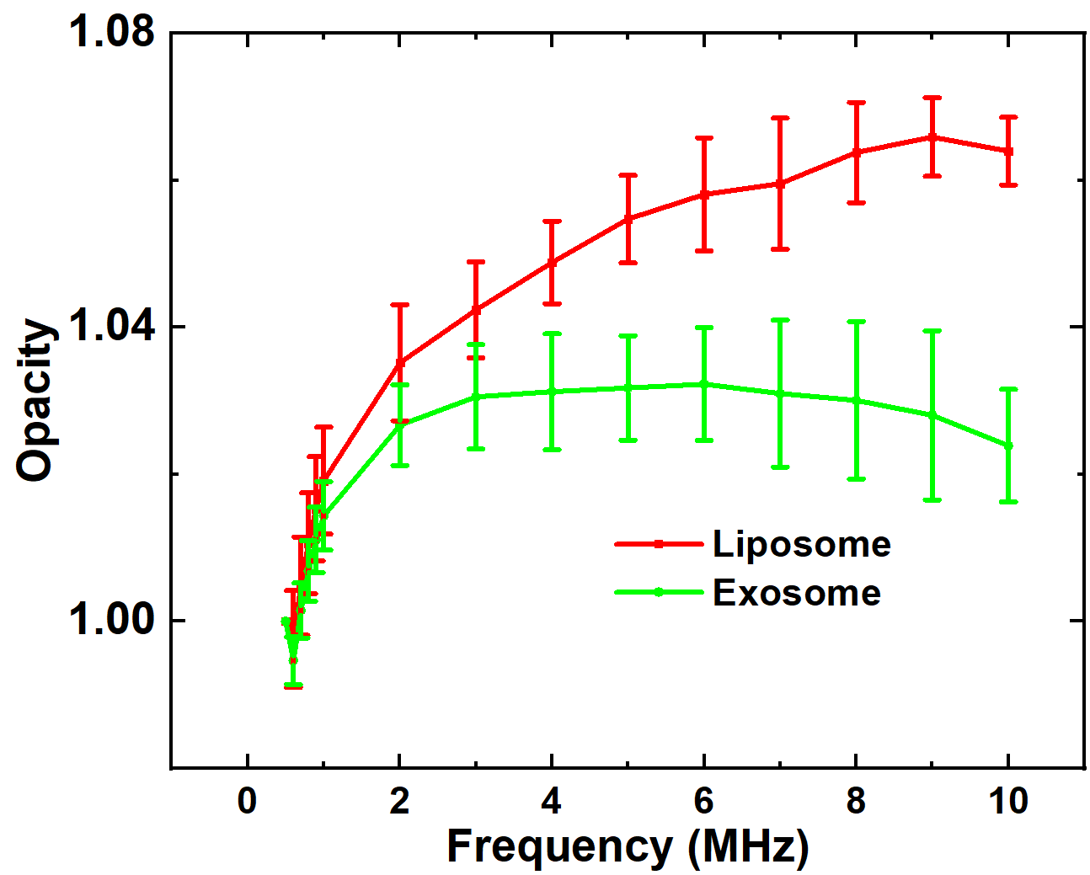
Characterization of Exosomes Based on Their Unique Dielectric Properties by A Novel Electrical Impedance Measurement System
Yuqian Zhang ¹, Leilei Shi ¹, and Leyla Esfandiari ^{1,2}
¹ Department of Electrical Engineering and Computer Science and ² Department of Biomedical Engineering, University of Cincinnati, Cincinnati, Ohio, USA.
INTRODUCTION
DETECTION PRINCIPLE
Liposomes with known dielectric properties as model system
Exosomes belong to the cell-secreted extracellular vesicles family with diameters of ~30-150 nm, released from many cell types into the extracellular space. They are composed of a lipid bilayer membrane containing various receptors and tetraspanin surface markers. They also encapsulate nucleic acids and proteins, and their components reflect their cellular origin. Thus, exosomes have been considered as circulating biomarkers for early diagnosis and therapeutics in liquid biopsy. However, conventional proteomic profiling and genomic characterization methods change the physical structure of the exosomes by labelling and lysing steps.
Here, we report a novel insulator-based dielectrophoretic (iDEP) device to rapidly entrap exosomes from biofluids, followed by the electrical impedance measurements to non-invasively characterize exosomes based on their unique dielectric properties.
Maxwell’s mixing theory is applied to analyze the dielectric behavior of biological particles in suspension under an AC voltage at varied frequencies:
a)
b)
CH:PC_{(10:1)}
CH:PC_{(1:10)}
SCHEMATIC OF DETECTION PLATFORM
The schematic illustration of the impedance measurement system
The membrane capacitance: CH:PC_{(1:10)} = 3.14×10⁻¹⁷ F ; CH:PC_{(10:1)} = 4.19×10⁻¹⁷ F
Higher opacity magnitude was observed in the liposomes with higher membrane capacitance CH:PC_{(10:1)}
Equivalent circuit developed by Foster and Schwan: amplitude of the impedance $∝$ capacitance of the membrane
RESULTS
Exosomes entrapment and characterization
$$Z=R_{in}∗\left(\frac{V_{in}}{V_{amp}}−1\right)−R_{out}$$
$$Z=\frac{1}{jwC_{mem}}$$
Characterization of exosomes from different origins
a)
b)
The schematic illustration of the iDEP device
The characterization and quantification vesicles verified that exosomes were successfully isolated from biofluids and E-field had minimal impact on exosome morphology and integrity.
The opacity of exosomes cultured in PA was lower than PA+GW mixture.
Exosomes from PA-treated hepatocytes displayed increased membrane proteins, resulting in lower membrane capacitance.
GW4869 as inhibitor inhabited the biosynthesis and reduced the effect of PA.
Comparison of particles with different dielectric properties
Polystyrene beads (-27.99 mV) , liposomes (-12.68 mV) and exosomes (-12.69 mV).
CONCLUSIONS
a)
b)
An innovative electrical impedance measurement system was developed to non-invasively trap and characterize exosomes from different origins.
The characterization and quantification of vesicles verified that exosomes were successfully isolated from biofluids and E-field had minimal impact on exosome morphology and integrity.
Liposomes with known dielectric properties as model system demonstrated the feasibility of differentiating membrane capacitance at the MHz frequency range.
Distinguishable opacity of exosomes under different culture conditions was observed to represent the difference between membrane composition as their biogenesis was subjected to systematic change.
DEP
$${ F}_{DEP}=2πr^{3}ε_{m}Re(f_{CM})∇E^{2}$$
$F_{DEP}$is the dielectrophoretic force, r is the radius of the exosomes, $Re(f_{CM})$is the real part of Clausius-Mossotti factor, and defined as:
$Re(f_{CM})$= ($σ_{p}−σ_{m}$)/($σ_{p}+2σ_{m}$)
Where, $σ_{p}$ $and σ_{m}$ are the conductivities of particle and suspending medium.
$$F_{EP}=6πηrμ_{EP}E$$
EP
$F_{EP}$is the electrophoretic force, $η$ is the solution viscosity, E is the applied electric field, and $μ_{EP }$is the electrophoretic mobility and presented as:
Impedance result was presented as opacity: defined to normalize the number of particles entrapped at different experiments.
$$O\left(f\right)=\frac{Z(f)}{Z(0.5MHz)}$$
ACKNOWLEDGEMENTS
$μ_{EP}$= ($2ζ_{p}ε_{m})/(3η)$
The authors thank Dr. C. Blenkiron and Dr. T. Nakamura for providing the exosome samples from placental villous tissue human hepatocellular carcinoma (HuH-7) cells.
Where,${ ζ}_{p}$ is the zeta potential of the particle, $ε_{m}$ is the permittivity of suspending medium.
REFERENCES
$$F_{EOF}=6πηrμ_{EOF}E$$
in which $Z(f)$is defined as the impedance magnitude at frequency $f$ , and $O\left(f\right)$ is the resulting opacity magnitude at the corresponding frequency.
[1] L. Shi, D. Kuhnell, V. Borra, S. Langevin, T. Nakamura, and L. Esfandiari. Lab on a chip (2019). DOI: 10.1039/C9LC00902G
[2] L. Shi, A. Rana and L. Esfandiari. Scientific reports 8.1 (2018): 6751. DOI: 10.1038/s41598-018-25026-2
[3] A. Rana, Y. Zhang, and L. Esfandiari. Analyst 143.13 (2018): 2971-2991. DOI: 10.1039/C7AN01965C.
[4] T. Sun, and H. Morgan. Microfluidics and Nanofluidics 8.4 (2010): 423-443. DOI: M10.1007/s10404-010-0580-9.
EOF
$F_{EOF}$is the electroosmotic force, $μ_{EOF }$is the electroosmotic mobility and evaluated as:
The opacity of exosomes was detected to be lower than liposomes: membrane of the exosomes is enriched with charged surface markers, resulting in lower membrane capacitance compared with liposomes
$μ_{EOF }$ = -($ε_{m}ζ)/(4πη)$
Where, $ζ$ is the zeta-potential of the glass wall of the micropipette.

